Slide 1
Light Vocabulary
6th Grade Science

Slide 2
Visible Light
The wave energy we can see
Made of many colors
Light waves travel in straight lines

Slide 3
Radiant Energy
Energy given off by the sun
Travels in waves
Another name for light energy

Slide 4
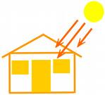
Absorb
When light waves enter a substance and change into other forms of energy.
Darker colors absorb more light

Slide 5
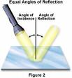
Reflect
When light waves bounce off something else

Slide 6
Media Clip: Reflection

Slide 7
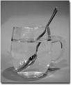
Refract
When light waves bend
Light waves are refracted as they pass through water.

Slide 8
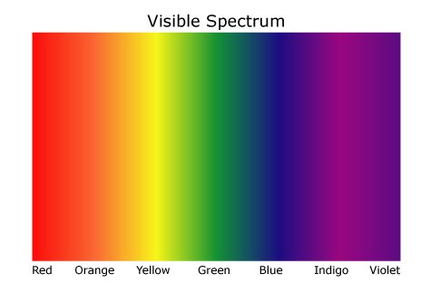
Spectrum
White light is made of all the colors of the rainbow.

Slide 9
ROY G BIV
The colors of the rainbow
Red, Orange, Yellow, Green, Blue, Indigo, Violet
Red has the longest wavelengths
(bent the least)
Violet has the shortest wavelengths (bent the most)

Slide 10
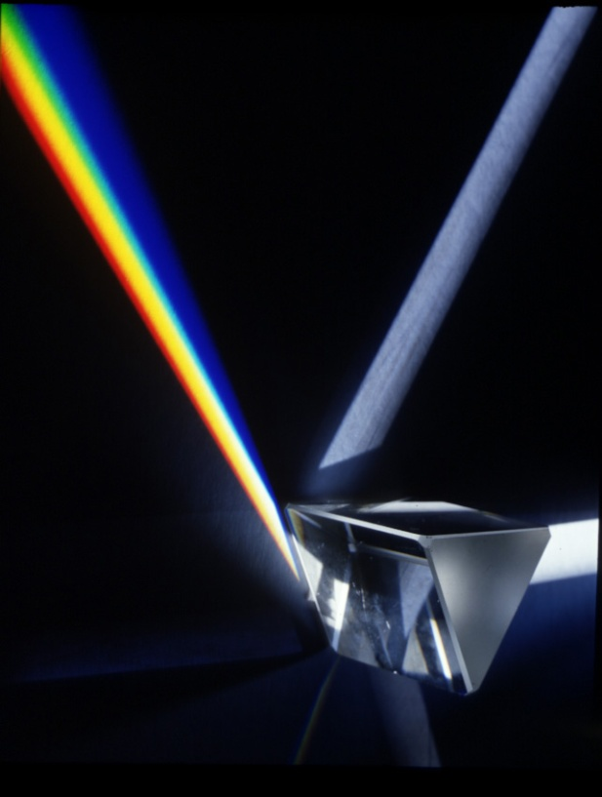
Prism
A piece of glass or plastic that bends light waves

Slide 11
Media Clip: Refraction

Slide 12
Opaque
An object that does not allow light waves to pass through it
You cannot see through these objects

Slide 13
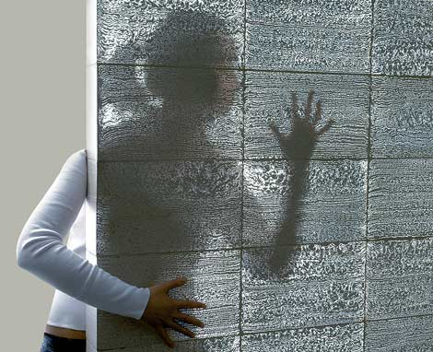
Translucent
An object that allows a few light waves to pass through it
You can almost see through these objects.

Slide 14
Transparent
An object that allows light waves to pass through
You can see through these objects

Slide 15
Media Clip: Translucent, Transparent, Opaque

